Slide 1
The eagle-I Resource Ontology (ERO)
The eagle-i resource ontology (ERO) describes research resources (regents, biospecimens, cell lines, software, instruments, services, training opportunities, etc)
It is comprised of a domain ontology layer (publically released community model, OBO Foundry candidate) that re-uses terms from many community ontologies, and an application ontology layer that contains modeling needed to drive the eagle-i data entry and search applications
Links: (paper) (website) (ontology)

Slide 2
Stem Cell Line Modeling in eagle-i
In 2014 stem cell modeling was expanded significantly in the eagle-I ontology
Modeling was driven by search and discovery use cases from NYSCF (http://nyscf.org/), and various institutional stem cell core facilities such as the Harvard Stem Cell Institute (http://hsci.harvard.edu/), who wanted to describe and advertise their cell lines using the eagle-i ontology and tools
A light-weight search API leverages the eagle-i software and a subset of the eagle-i model to drive cell line search on the NYSCF website (http://nyscf.org/repository)
The complete eagle-i model is implemented in resource curation and search tools
example iPS cell line record in eagle-i: https://goo.gl/HIH9oY
ontology browser record for ‘stem cell line’: https://goo.gl/PTVY5l

Slide 3
Exemplar Competency Questions
Show me all iPSC lines related to Schizophrenia that can make cortical neurons
Show me iPSCs that are good at making endodermal lineages
Show me all ALS related iPSC lines that also have genome corrected control lines made from them
Show me iPSCs that have been validated with EB or tetraploid complementation assays and were made without integrating DNA sequences.
Show me any iPSC line or ES line that has RNASeq data available on the undifferentiated cell line.
Show me all GMP certified iPSCs that have mutations related to Parkinson’s disease

Slide 4
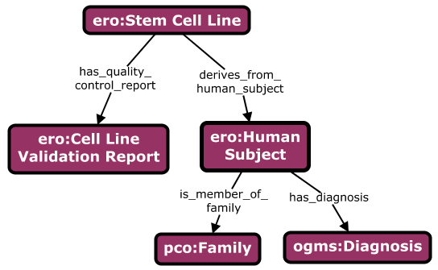
Stem Cell Line Modeling in eagle-i
There are five ‘hubs’ in the model (instantiated classes about which we collect data):
Stem cell lines
Cell line validation reports (in which they are characterized)
Subjects (from which they derive)
Families (of which human subjects are members)
Diagnoses (which characterize diseases borne by subjects)
Attributes of each of these nodes is collected in the eagle-i application according to our ontological model

Slide 5
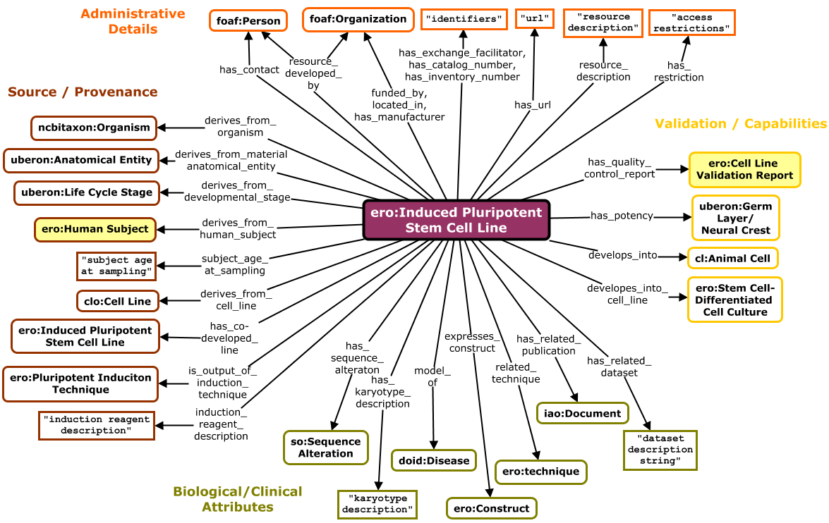
Stem Cell Model
Notes:
Note that these diagrams describe the data model we used to collect metadata (properties that CAN hang from the central class).
They are not meant as an ontological diagrams depicting all-some patterns.

Slide 6
Model Features
Largely wheel-and-spoke to support efficient metadata collection
Application requirements required creating many bespoke properties for capturing specific information (e.g. derives_from_human_specimen instead of derives_from) . . .
But these application properties are classified under community properties where possible
e.g. derives_from_human_specimen is a subPropertyOf dervies_from
A more re-usable model would require generalizing these bespoke properties required for the application, to use their RO-compliant parents

Slide 7
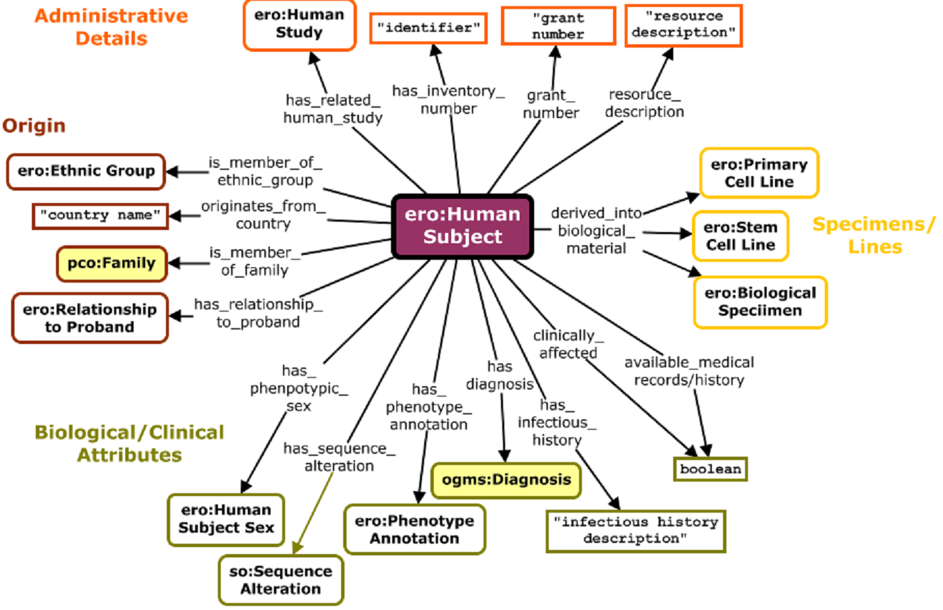
(Human) Subject Model

Slide 8
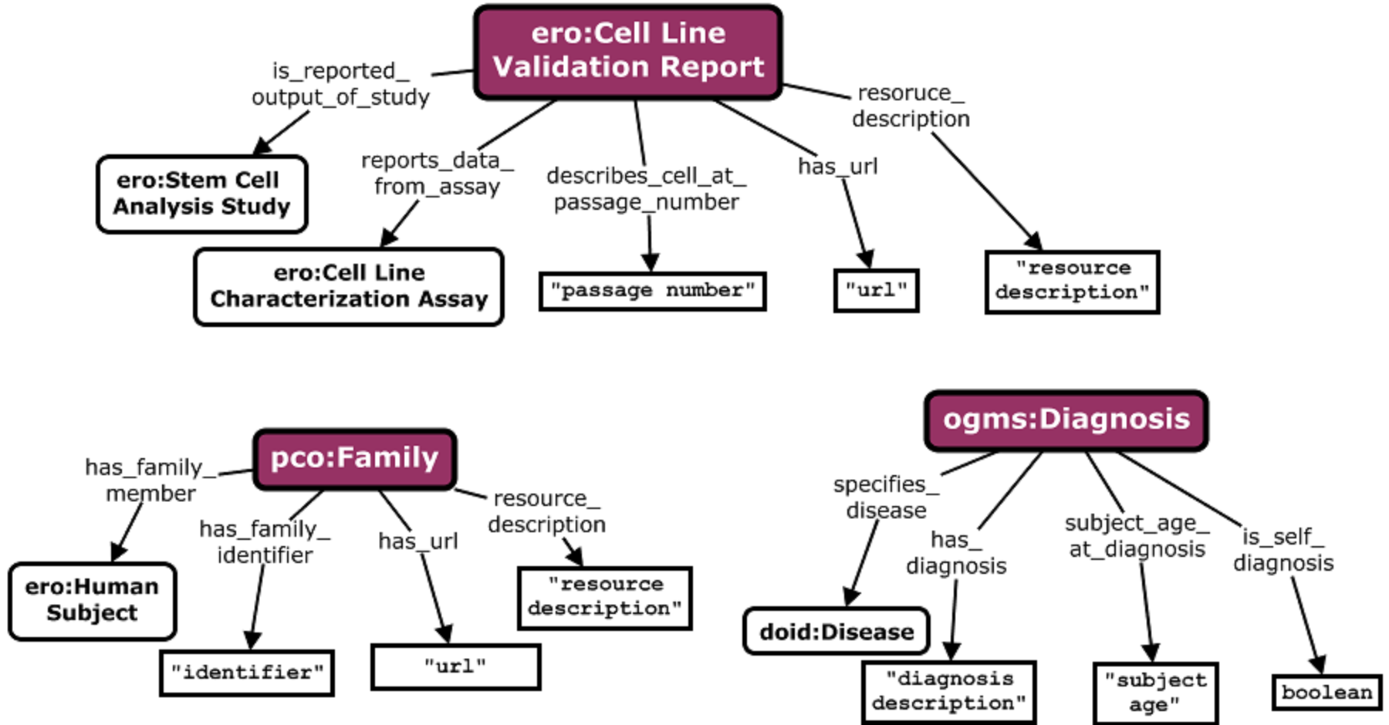
Report, Family, Diagnosis Models

Slide 9
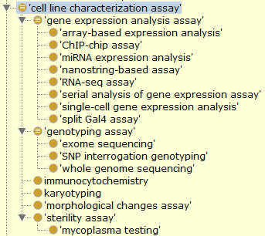
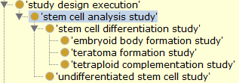
Related Techniques
Focus of our work was not methods – so this is a needed area of expansion.
Shown here are hierarchies of techniques under ‘cell line characterization assay’, and ‘stem cell analysis study’
*Note that many techniques currently defined in ERO need to move into OBI and be MIREOTed back into ERO (on our long list of things to do)

